Slide 1
Define the Scope of the Organization and Assess Its Goals Organizational Design
Mustafa Degerli
November, 2016 – METU II

Slide 2
Agenda
Organizational design
Characteristics of a well-designed organization
Outline of the step-by-step approach
The information-processing view
Organization
Scope
Goals

Slide 3
Organizational design
The complete specification of
strategy,
structure,
processes,
people,
coordination and control, and
incentive components of the firm (company)

Slide 4
Organizational design
An ongoing executive process that includes both
short-term, routine changes
intermittent, larger-scale changes
Starts with the organization’s goals, and from there we work from the top to the bottom
Considering strategy, structure, process, people, coordination, and control

Slide 5
Organizational design
Fundamental design principles underlie any well-functioning organization.
What are our goals?
What are the basic tasks?
Who makes which decisions?
What is the structure of communication?
What is the incentive structure?

Slide 6
Organizational design
Two complementary problems
How to partition a big task of the whole organization into smaller tasks of the subunits
How to coordinate these smaller subunit tasks so that they fit together to efficiently realize the bigger task or organizational goals

Slide 7
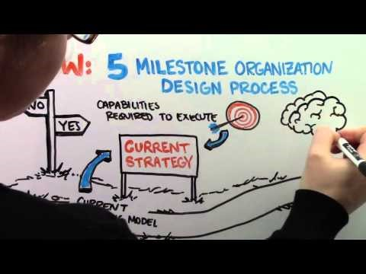
Organizational design
https://youtu.be/41v3PENTEXw

Slide 8
Characteristics of a well-designed org
Direct sufficient management attention to sources of competitive advantage in each market
Help the corporate parent add value to the organization
Reflect the strengths, weaknesses, and motivations of people
Take account of all the constraints that may impede the implementation
Protect units that need distinct cultures

Slide 9
Characteristics of a well-designed org
Provide coordination solutions for the unit-to-unit links that are likely to be problematic
Have legitimate parent levels and units
Support effective controls
Facilitate the development of new strategies and provide the flexibility required to adapt to change

Slide 10
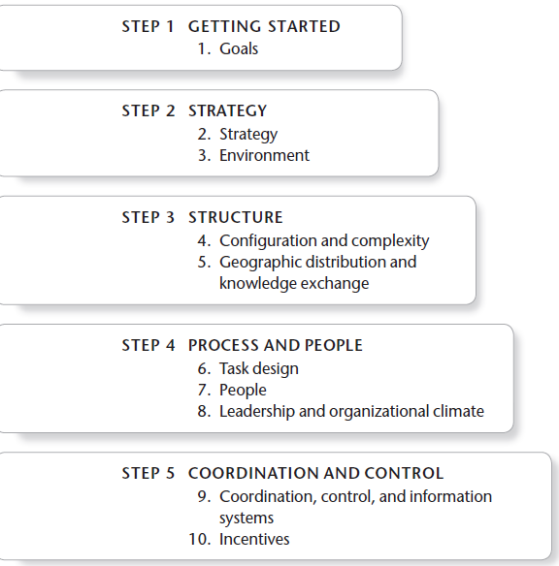
Outline of the step-by-step approach

Slide 11
The information-processing view
An organization uses information in order to coordinate and control its activities in the face of uncertainty
Uncertainty is an incomplete description of the world
By processing information, the organization observes
What is happening, analyzes problems, and makes choices about what to do, and communicates to others

Slide 12
The information-processing view
Information processing
Observing, transmitting, analyzing, understanding, deciding, storing, and taking action for implementation
Learning, tacit versus explicit knowledge, knowledge management, and data mining
The greater the uncertainty of the task, the greater the amount of information that has to be processed between decision makers

Slide 13
Organization
Organization
an intentionally coordinated social entity,
with a relatively identifiable boundary,
which functions on a relatively continuous basis
to achieve a common goal or a set of goals
Can be a team, department, division, an entire company, or even a set of companies

Slide 14
Scope
The smaller tasks must be defined and arranged in a way that allows effective coordination
These smaller tasks are then integrated so that the large corporation or project realizes the desired goals
Breaking down big tasks and putting smaller ones together are repeated again and again in many forms

Slide 15
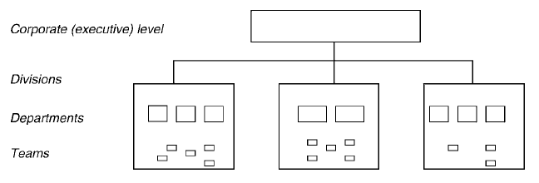
Scope
Often the best place to start will be at the corporate level
Design the upper levels first
Once that part has been designed, move on to the next levels (departments or divisions)

Slide 16
Goals
Two fundamental goals: Efficiency and effectiveness
Efficiency is a primary focus on inputs, use of resources, and costs
Efficiency, focusing on minimizing the costs of producing goods or services
Effectiveness is a focus more on outputs, products or services, and revenues
Effectiveness, focusing on generating revenues or seizing leading-edge innovation in the marketplace

Slide 17
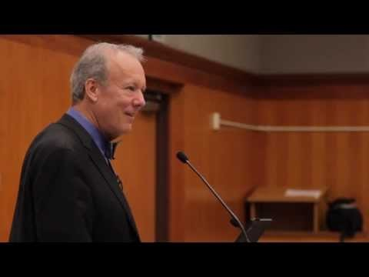
Goals
https://youtu.be/B4QQZvqRtzA

Slide 18
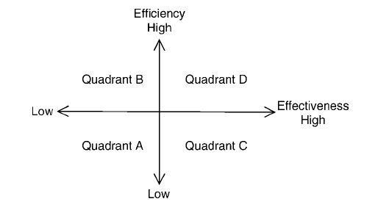
Goals
Q A: Little focus on using resources well and it has few or no specific goals related to higher-level ideas or targets

Slide 19
Goals
Q B: Focus on utilization of the smallest amount of resources necessary to produce products or services

Slide 20
Goals
Q C: Highly volatile environments or in situations where the organization constantly develops new ideas and has a first mover advantage and, as such, treats the costs of resources as a secondary concern

Slide 21
Goals
Q D: Confront competitive, complex and volatile environments that require both product innovations and low cost in order to compete successfully

Slide 22
Goals
The choice of a goal state in relation to efficiency and effectiveness has profound consequences
The efficiency-effectiveness goal state affects the choice of proper organizational design
Pursuit of efficiency and effectiveness must be present everywhere in the organization at all times
Successful business units were able to simultaneously develop capacities related to both efficiency and effectiveness

Slide 23
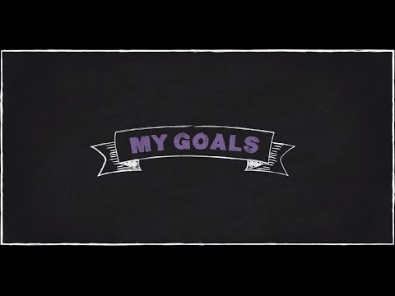
Goals
https://youtu.be/k-9vqTcxkLI

Slide 24
References
Burton, R. M., Obel, B., & DeSanctis, G. (2011). Organizational Design - A Step-by-step Approach. Second Edition. Cambridge University Press.
What is Organization Design? https://youtu.be/41v3PENTEXw
Goold, M. & Campbell, A. (2002). Do You Have a Well-Designed Organization? Harvard Business Review.
Efficiency vs Effectiveness https://youtu.be/B4QQZvqRtzA
SMART Goals https://youtu.be/k-9vqTcxkLI

Slide 25
Mustafa Degerli
MD@mustafadegerli.com

